Slide 1


DXC REAL-TIME PROJECTS
Presented by- Aakriti Singh
Roll No.- DXC262AB1202
Batch - DXC-262-Analytics-B12-Azure
Instructor Name - Mr. Ajay

Slide 2
Projects
Smart Vehicle
This project is designed to store IOT data coming from cloud which will be validated and moved to Azure's SQL database.
AP Morgan Data Platform
This project is designed to build a pipeline which will connect and create a linked service of Azure Databricks and the Azure Data Factory.

Slide 3
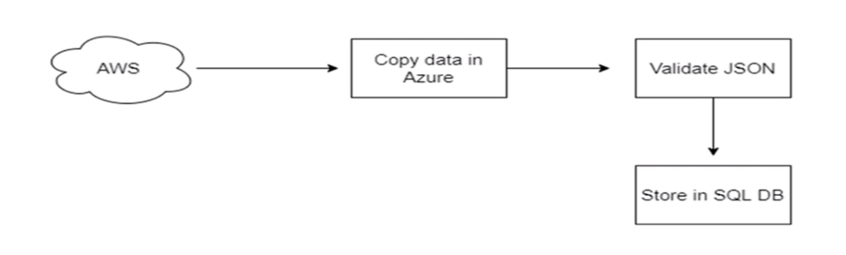
Smart Vehicles
Problem statement:
General motors is one of the leading heavy vehicle manufacture company. To improve they are planning to roll out lot new features based on IOT.
Vehicle has third party IOT device which will send the telemetry data in JSON format over the AWS cloud. In our case since we don’t have access to AWS Cloud, we will input the data on our own.
We need to validate the data ,once data gets validated this data would be stored in SQL database which will further be utilized by data science team.

Slide 4
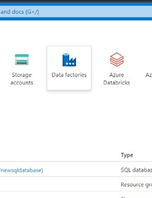
STEP-1
- Create Azure Data Factory Account For Data pipelines-
Login to Microsoft azure and search for Data Factory then open it.
Smart Vehicles

Slide 5
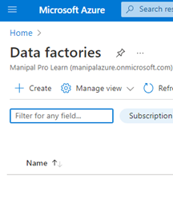
2. Click on +Create option.

Slide 6
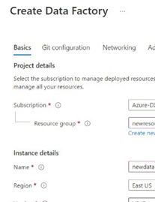
3. Enter the details about the Data Factory account like the resource group and ADF name. I named the ADF as automobile .Click on review +create and finally click on create.

Slide 7
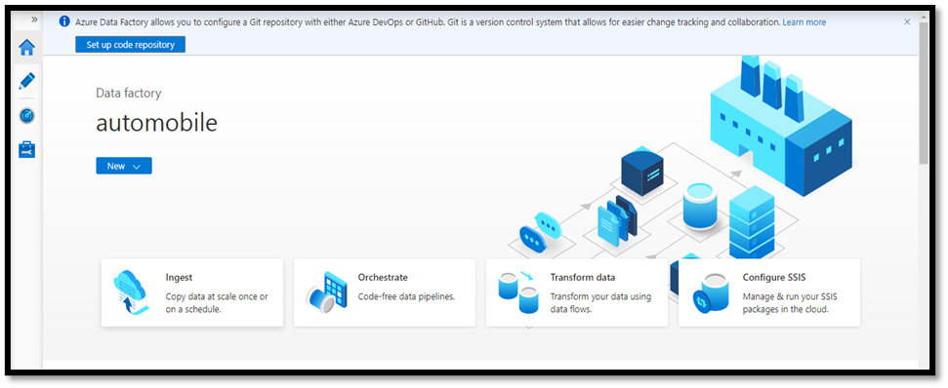
4.Deploy The ADF . After Deployment is complete, click on Go to Resource group. Then, open Azure Data Factory Studio.

Slide 8
Create Azure SQL Server and Database.
STEP-2
1.Open Microsoft azure search for SQL database and open it.

Slide 9
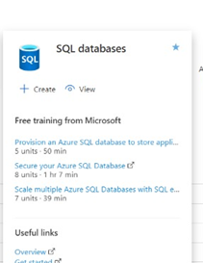
2 . Click on +Create.

Slide 10
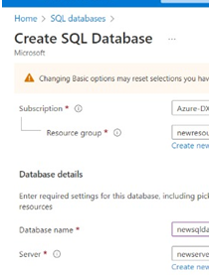
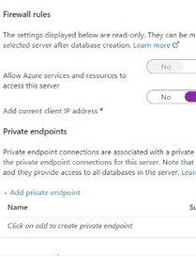
3.Enter the details like new resource group,database name and assign a server and password for database.In networking section turn "current client IP address" to 'YES‘. Rest skip all and click on Review+Create.

Slide 11
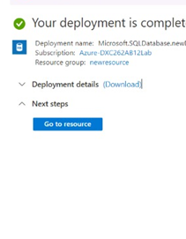
4.Deploy the Azure SQL Database and click on Go to Resource.

Slide 12
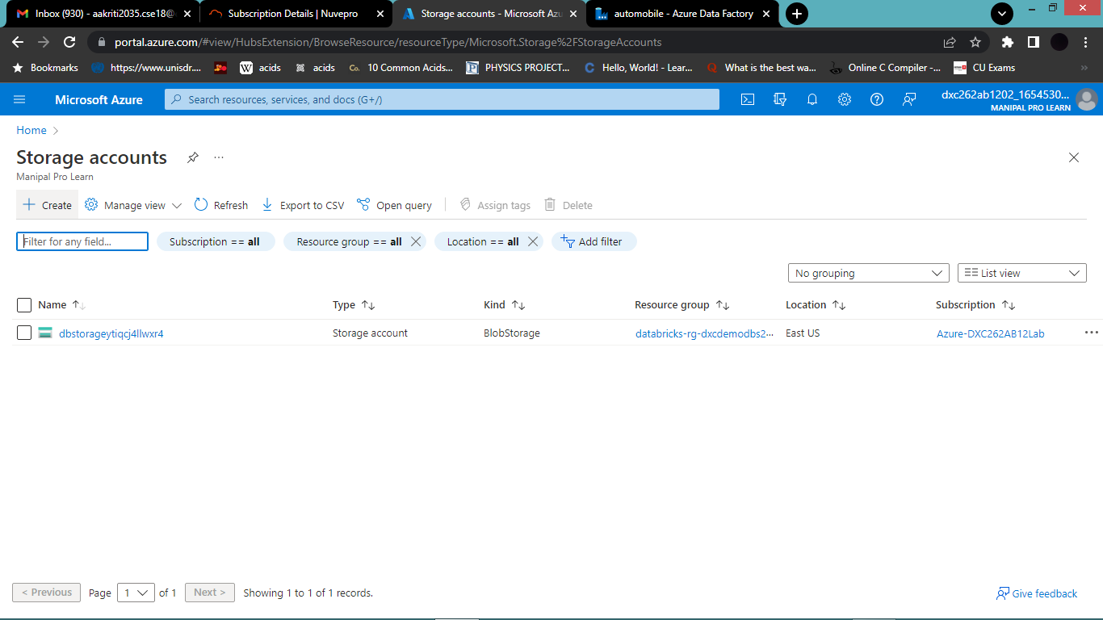
STEP-3
Create Azure Storage Account.
1. Go to Home in Azure ,Search for Azure Storage Account in search box. Open it.Click on +Create.

Slide 13
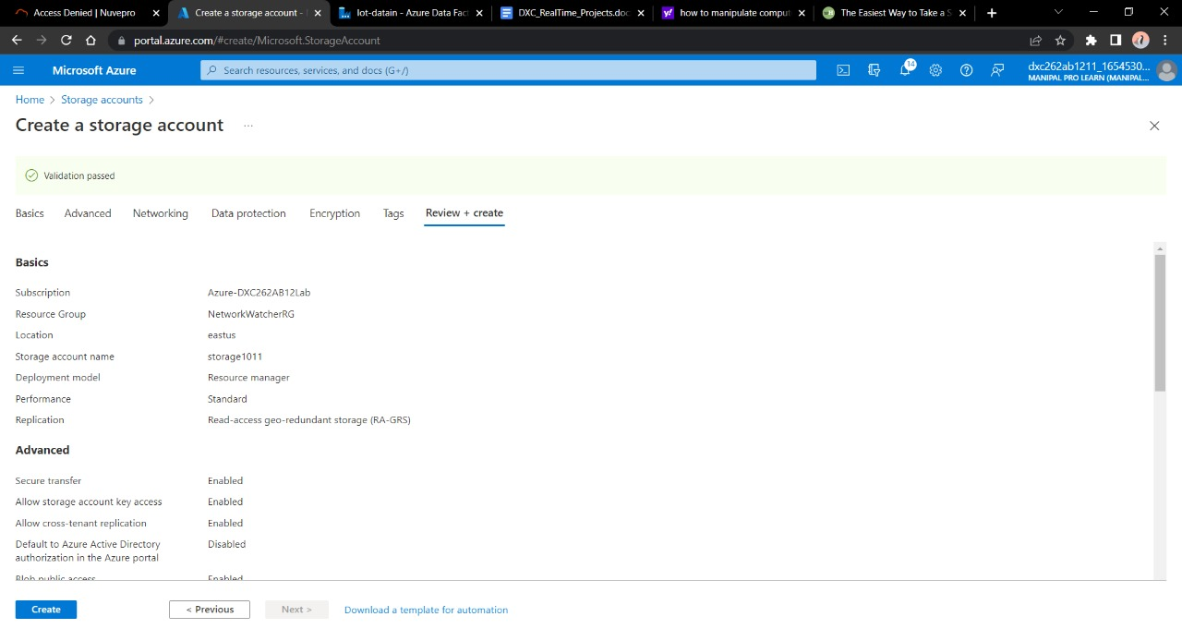
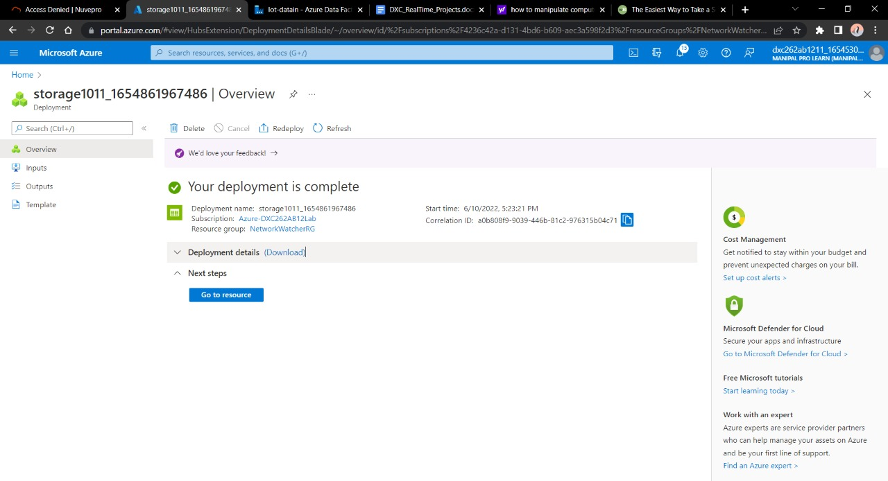
2. Fill in all the details and deploy the storage account.

Slide 14
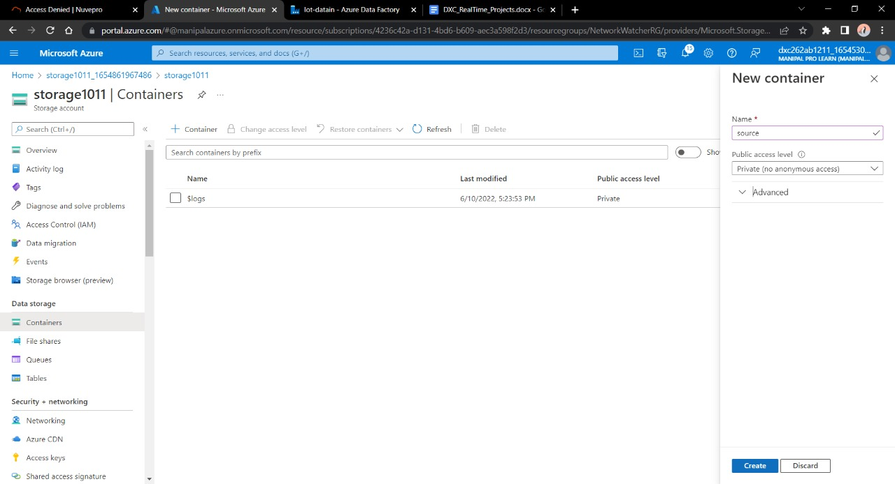
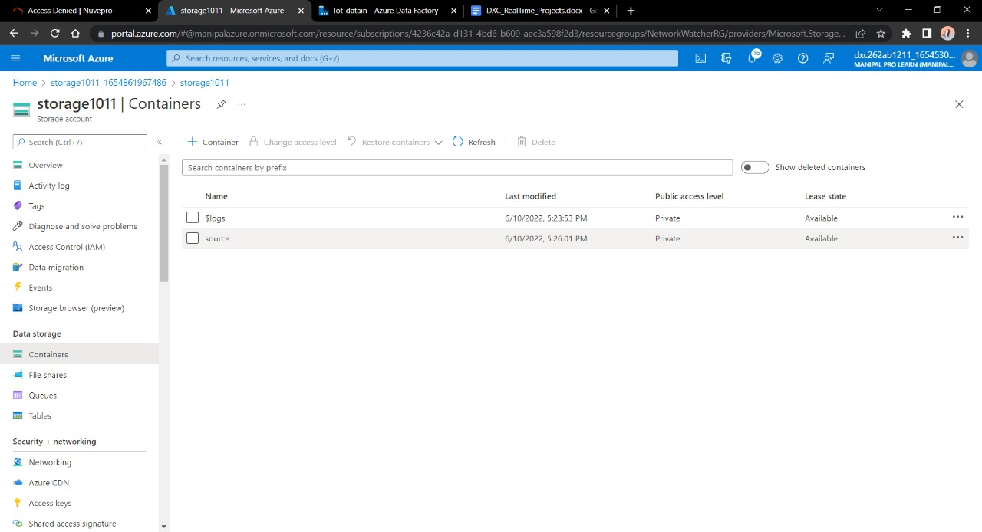
3 .Click on Container → +Container. Create a file called Source in that Container. The Source is the file where our Input Data will be present or land to be validated. Click on Source and upload the data in it. In this case, I took an already validated CSV file, but to use JSON data from AWS Cloud, we need to create another linked service.

Slide 15
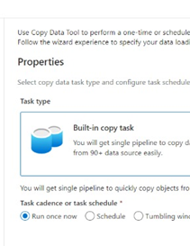
STEP-4
Create ADF Pipeline with triggers enable.
1.Go to ADF Studio again.Navigate it and click on Ingest. Click on copy task.

Slide 16
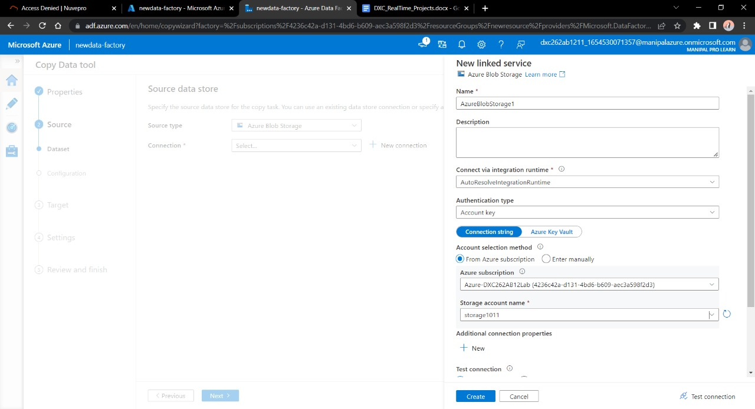
2.Create a blob storage data for source type connection. Select any name for the name of Azure blob storage linked file. Select the name of storage account name we created in this and click on Create.

Slide 17
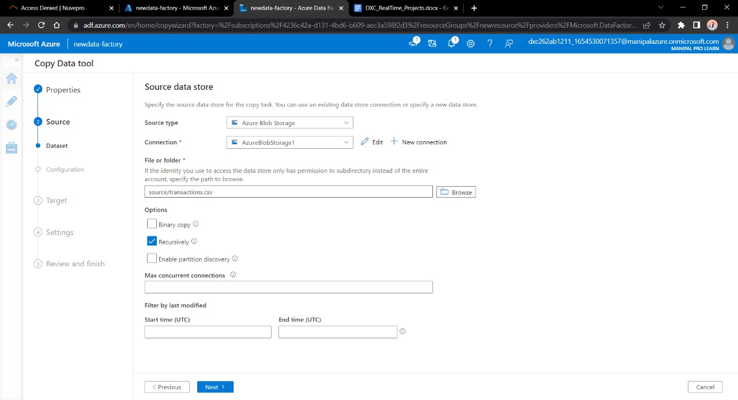
3.Select the source type as blob storage and connection name that we created in previous step. Click Recursively from Options. Click Next. Here , we are creating a linked service betweem ADF and Storage Account.

Slide 18
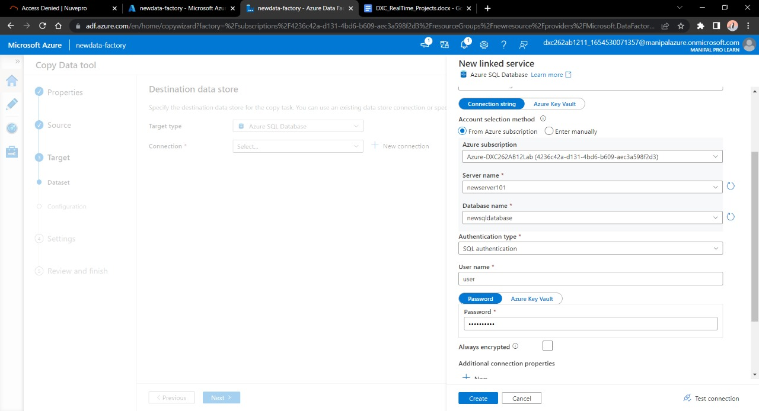
4.Now , in the next step we have to link this Data Factory with our SQL database we made earlier. Fill in the username and password used in SQL Database , click next.

Slide 19
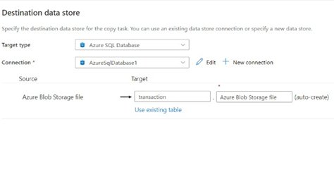
5.Add the destination blob data.

Slide 20
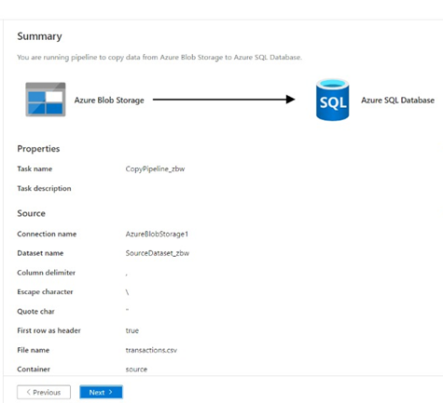
STEP-5
After pipeline is ready review and trigger it.

Slide 21
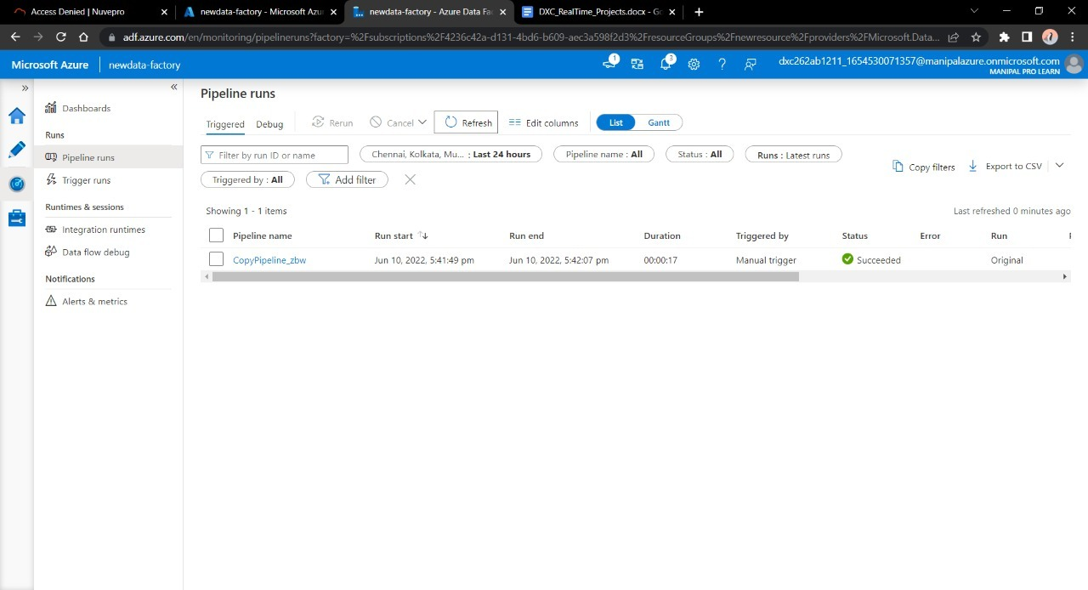
1. Go to ADF.Create the pipeline from Pipeline option. Enter the data asked in instructions and trigger the pipeline. Here we can observe pipeline is running successfully.

Slide 22
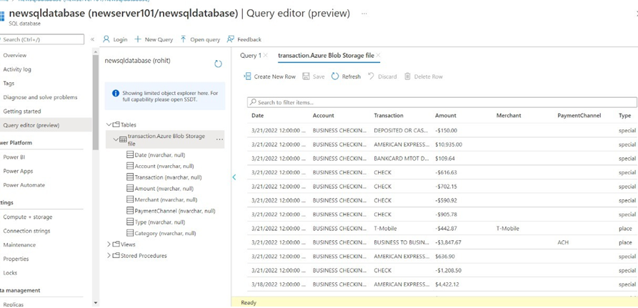
Smart Vehicles RESULT
Navigate to SQL database and here we can see our data is finally moved from Blob storage to SQL database. Thus, our task is complete.

Slide 23
PROJECT-2

Slide 24
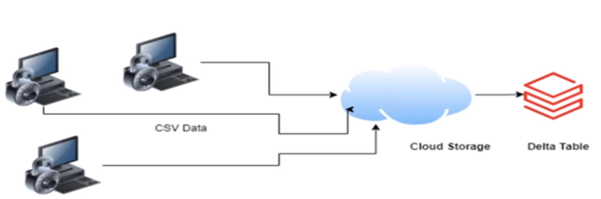
Project Description
The data that is generated in different platforms and stored on different devices like cloud needs to be processed to get a final database where we can do analysis.
AP Morgan
Data Platform

Slide 25
Problem statement:
Internal Application sends csv file in Azure data lake storage.
Validation needed to apply on this follows:
1.Check for duplicate rows. If it contains duplicate rows,file need to be rejected.
2. Need to validate the date format for all the data fields. Date column names and desired data format is stored in a Azure SQL server if validation fails file will be rejected.
Move all the rejected files to eject folder.
Move all the passed files to staging folder.
Write the passed files as the delta table in the Azure Databricks.

Slide 26
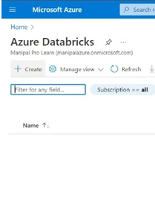
- Create a DataBricks workspace and create a cluster into it.
STEP-1
1.Navigate and open databricks and click on +create

Slide 27
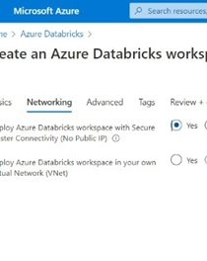
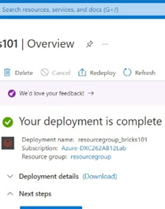
2.Give the details about the account required and deploy it.

Slide 28
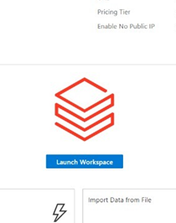
3.After the deployment is done , Launch Workspace.

Slide 29
- Create a DataBricks workspace and create a cluster into it.
STEP-2

Slide 30
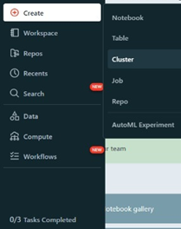
1.Click on Create cluster present in left slide.

Slide 31
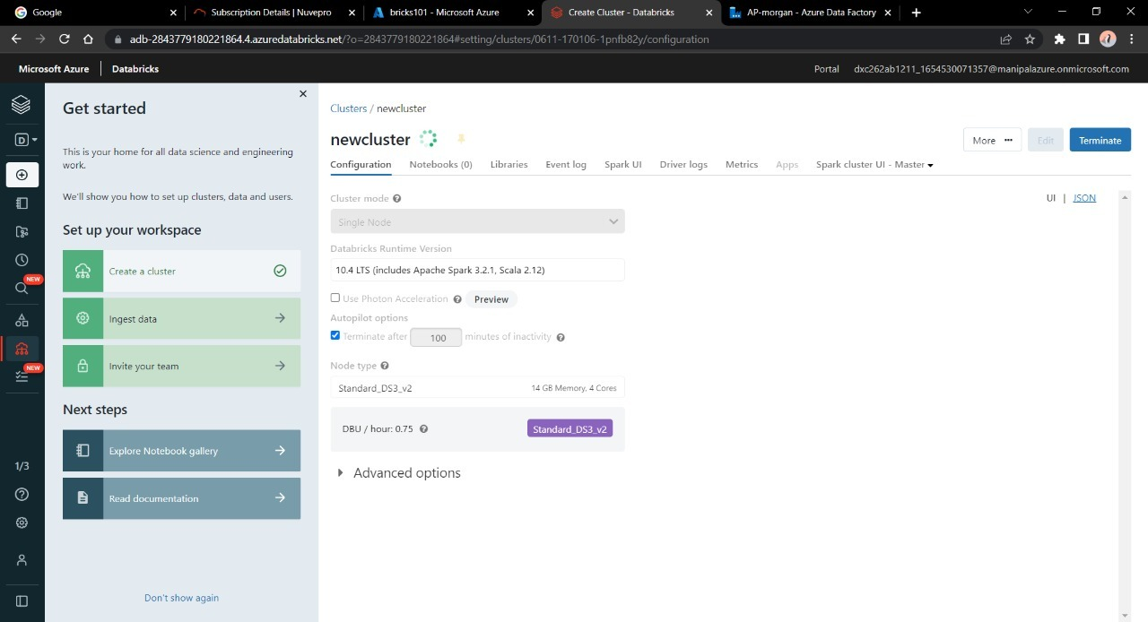
2.Enter the details for the cluster and click on create.

Slide 32
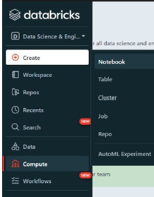
- Add notebook in Databricks and Implement the Business Logic
STEP-3
1.Navigate towards creating a Notebook and open it.

Slide 33
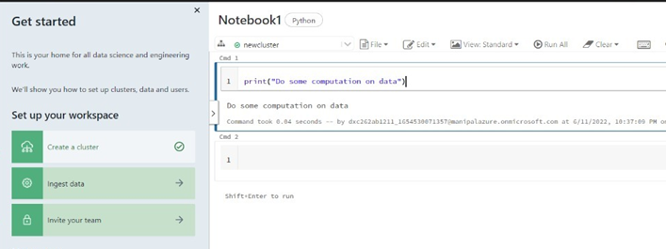
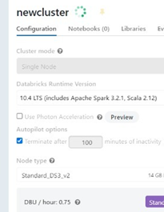
2.Here we are suppose to some data manipulation and validation with respect to data. We can upload the data from Data option, then open it with respective notebook. Observe that our cluster is attached with this notebook. Remember to save it.

Slide 34
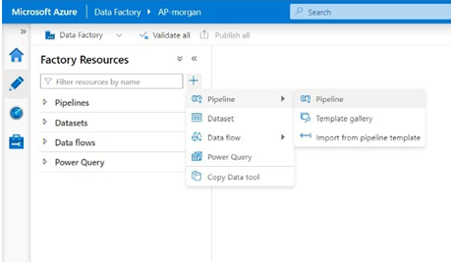
Add Azure data bricks linked service in Data Factory-
STEP-4
We then have to connect Notebook into Azure DF.
Deploy the Data Factory Account as mentioned in Project-1
1.Deploy ADF and open studio.
2.Click the pencil icon, Create a pipline by dropping a notebook that is created in the data bricks.

Slide 35
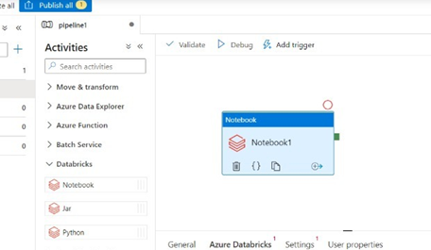
3.Give the details required to connect that Notebook. We can also add trigger to schedule the pipeline. It will schedule our movement of data via these pipelines according to our needs.

Slide 36
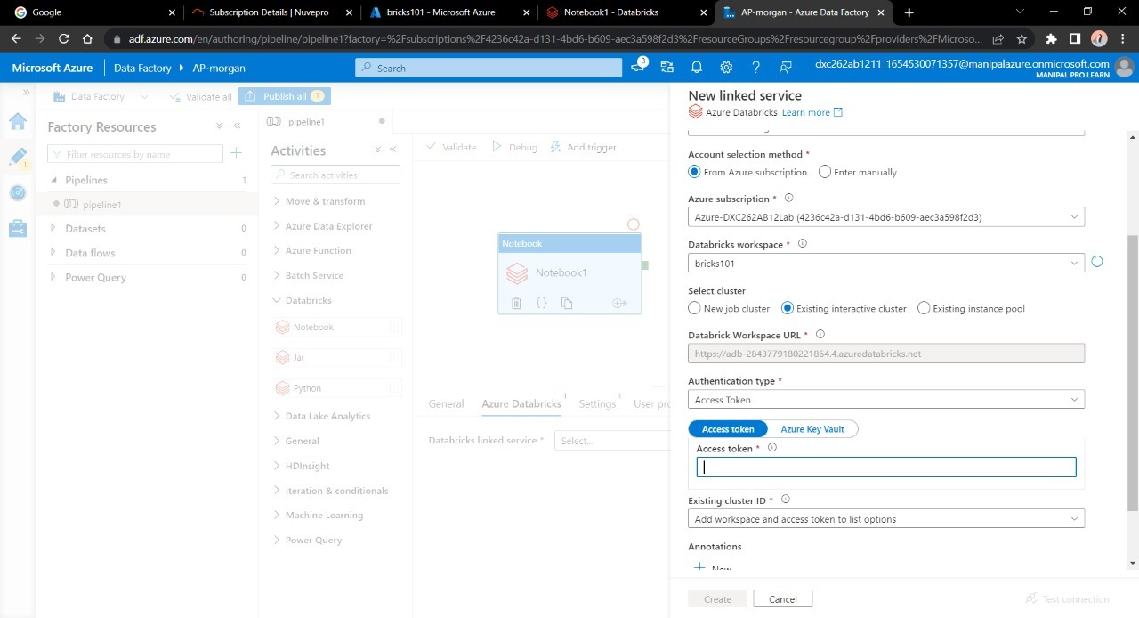
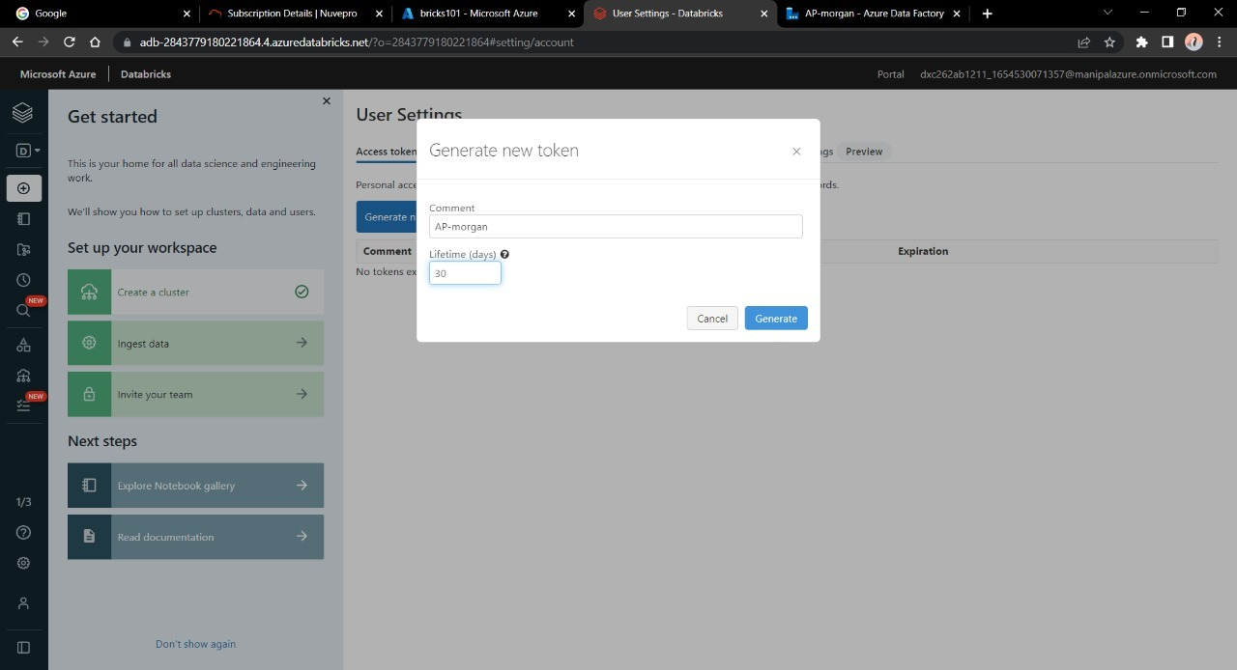
4.Click on new linked service , fill necessary data. Enter the cluster name in cluster ID . We need a token code to link both services. Go to data-bricks home, click on users → User Settings. Click on Generate Token. Copy the token on a Notepad.

Slide 37
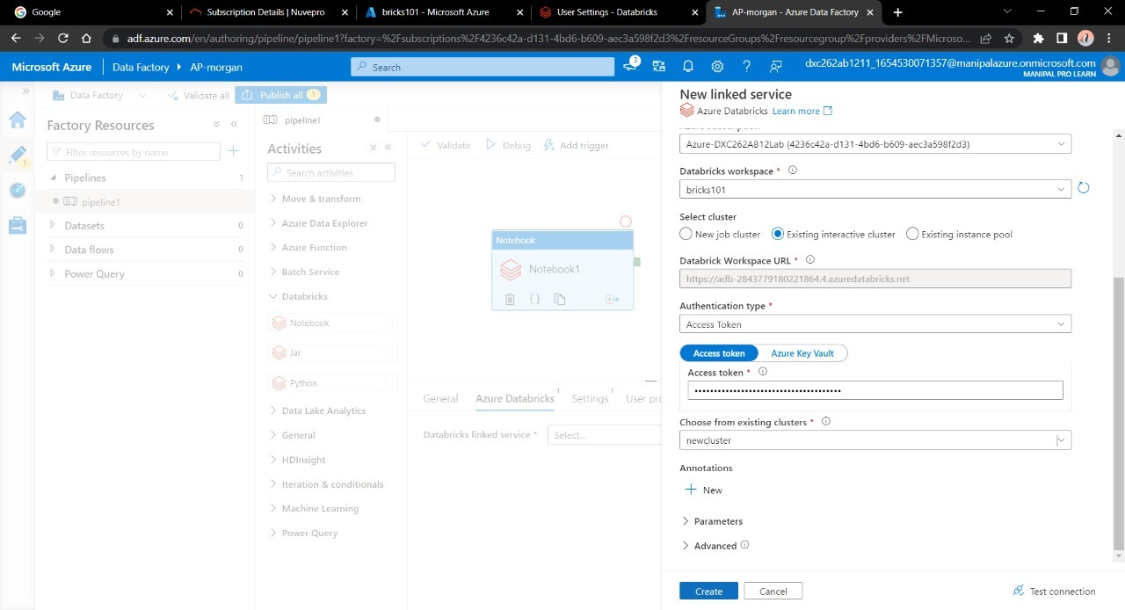
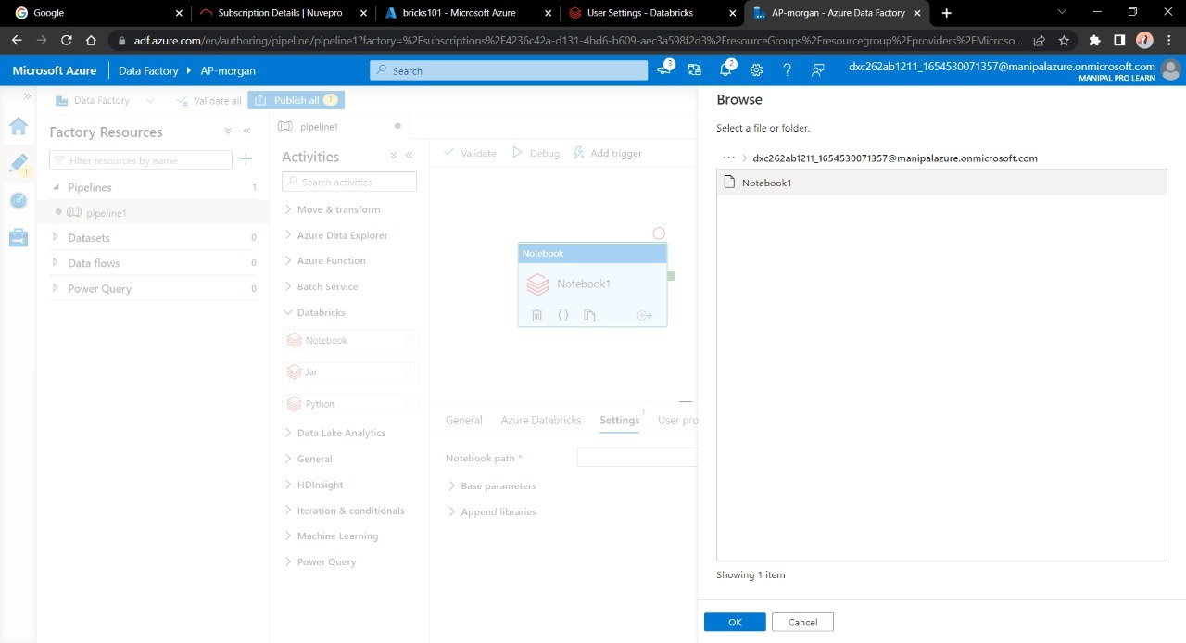
5.After this , go back to DF Link Configuration , paste the token from Notepad to it. Click Create. Now choose notebook from pipeline option to trigger it into Data Factory. Click OK. After this, click on Publish Now → Trigger.

Slide 38
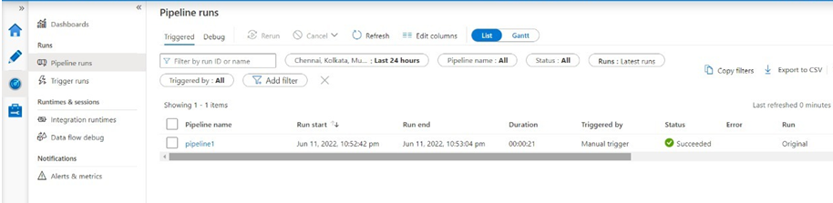
Final Result
Navigate towards monitor and here we have our pipeline created and triggered linking data bricks with azure data factory.

Slide 39
CONCLUSION-
Successful deployment with Azure Data bricks , Data Factory and Azure SQL database .
Better understanding of linking services within Azure platform.
THANK YOU ☺

